Slide 1



Find Empty Seats 空位即时找

Slide 2

Find Empty Seats 空位即时找
LMS
IT SUPPORT DELIVERY
ICATS
WORKSTATION BOOKING

Slide 3
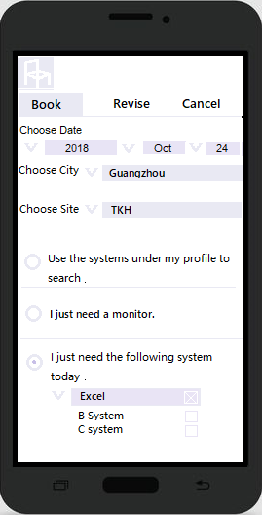
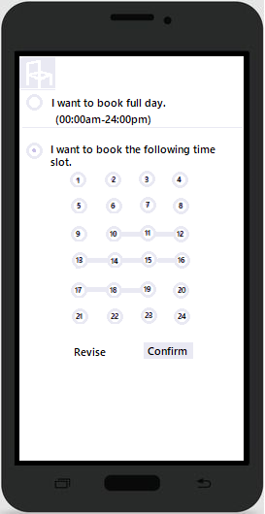
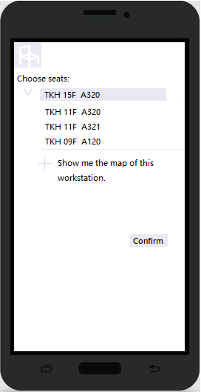
RED STRUCTURE Find Empty Seats 空位即时找

Slide 4
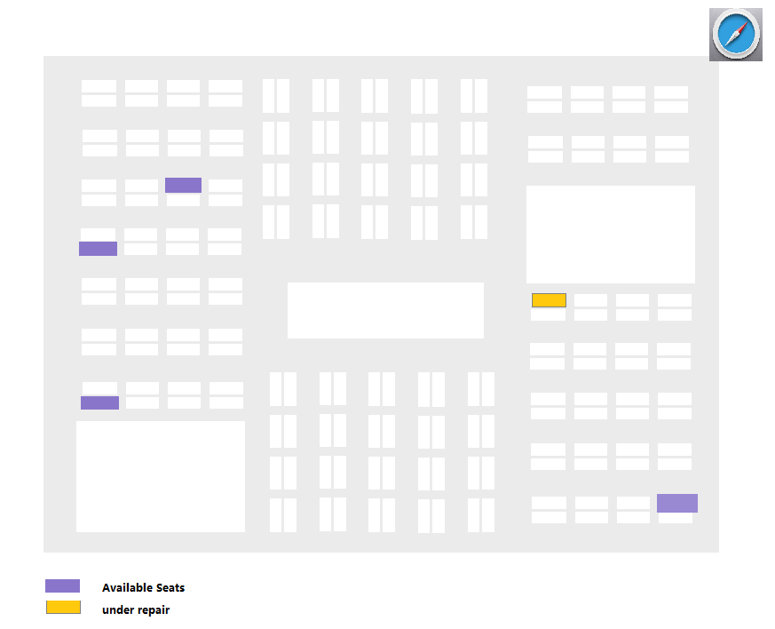
RED STRUCTURE Find Empty Seats 空位即时找
Lift
TKH15
TKH15/F

Slide 5
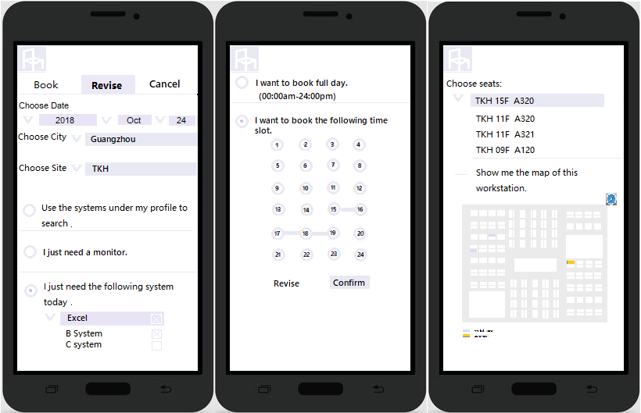
RED STRUCTURE Find Empty Seats 空位即时找

Slide 6
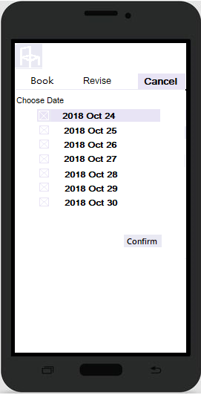
RED STRUCTURE Find Empty Seats 空位即时找

Slide 7
RED STRUCTURE Find Empty Seats 空位即时找
Thank You
Q&A

